Slide 1


Working with Multilingual Authority Records
Yoel Kortick
Senior Librarian
https://pixabay.com/en/books-library-shelves-1842306/

Slide 2


Introduction
The cataloging process for names
The cataloging process for subjects
Automated Preferred Term Correction
https://slidemodel.com/templates/animated-rainbow-business-powerpoint-template/
http://image.shutterstock.com/z/stock-photo-business-hand-writing-blank-agenda-list-130255148.jpg

Slide 3
Introduction
The purpose of using multilingual authority records is to be able to simultaneously
use authority control
maintain the option to decide in what language the preferred term should be

Slide 4
Introduction
A multilingual authority record may have preferred, non-preferred, and related terms in more than one language. These multiple terms are all in the same record.
Each language in the heading of the authority record is specified by a subfield 9
Thus in the same authority record there may be:
  several preferred terms in different languages
  several non-preferred terms in different languages
  several see-also terms in different languages
There will always be one preferred term per language

Slide 5
Introduction
For example
A work written in English by Menachem Begin should have 100 field
100 1_ a Begin, Menachem, d 1913-1992
and not
100 1_ a Begin, Menahem, d 1913-1992
A work written in Hebrew by Menachem Begin should have 100 field
100 1_ a בגין, מנחם, d 1913-1992
and not
100 1_ a בעגין, מנחם, d 1913-1992

Slide 6
Introduction
By cataloging the 100 as follows it is specified that the Latin form of the heading should be used in authority control
100 1_ ‡a Begin, Menahem, ‡d 1913-1992 ‡9 lat
By cataloging the 100 as follows it is specified that the Hebrew form of the heading should be used in authority control
100 1_ ‡a בעגין, מנחם, ‡d 1913-1992 ‡9 heb

Slide 7
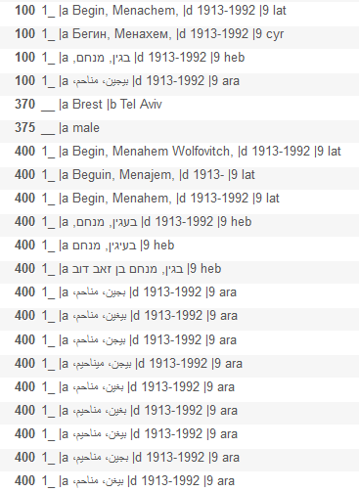
Introduction
A multilingual names
authority record
Preferred terms in four different languages
Latin non-preferred terms
Hebrew non-preferred terms
Arabic non-preferred terms

Slide 8
Introduction
The cataloging process for names
The cataloging process for subjects
Automated Preferred Term Correction
https://slidemodel.com/templates/animated-rainbow-business-powerpoint-template/
http://image.shutterstock.com/z/stock-photo-business-hand-writing-blank-agenda-list-130255148.jpg

Slide 9
The cataloging process for names
In the specific institution where multilingual authorities are used at least one of the name vocabularies in use must be a multilingual vocabulary.
In the institution here the NLI vocabulary is used.
NLI vocabulary is an example of a multilingual vocabulary.

Slide 10
The cataloging process for names
We will now look at two specific cases.
In both cases the same authority record will be used.
In the first case the record is in Latin characters so we will want the author to also be in Latin characters.
In the second case the record is in Hebrew characters so we want the author to also be in Hebrew characters.
By using the multilingual authority we are able to maintain authority control while also freely determining in what language the heading would be.

Slide 11
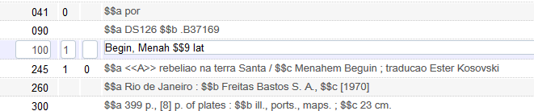
The cataloging process for names
Case one: we start by cataloging
1001_ $$a Begin, Menah $$9 lat

Slide 12
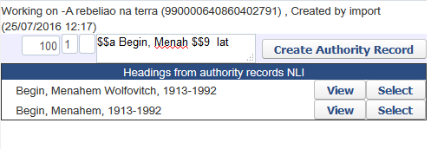
The cataloging process for names
After doing F3 we get this
Both of these are non-preferred terms.
We see only headings from the authority record which have subfield 9 “lat” because we have subfield 9 “lat” in the bibliographic heading from which we did F3
If we click “select” for either of these headings …

Slide 13
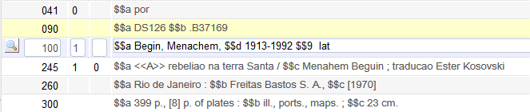
The cataloging process for names
We get the preferred term of the authority record and the preferred term is the one which has subfield 9 “lat”
Linked to authority record

Slide 14
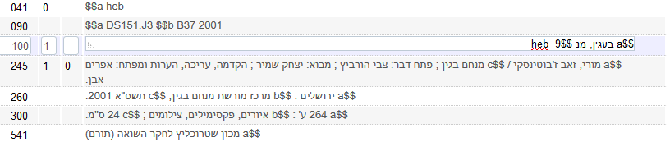
The cataloging process for names
Case two: we start by cataloging
1001_ | $$‏a‏ בעגין, מנ $$‏9‏ heb

Slide 15
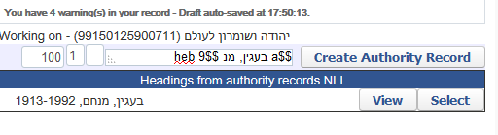
The cataloging process for names
After doing F3 we get this
This is a non-preferred term.
We see only headings from the authority record which have subfield 9 “heb” because we have subfield 9 “heb” in the bibliographic heading from which we did F3
If we click “select” for this heading …

Slide 16
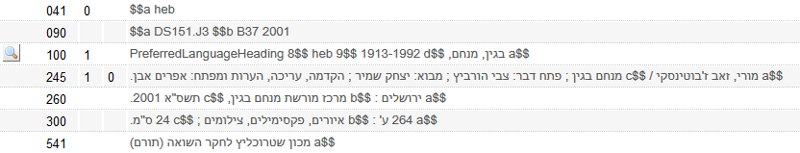
The cataloging process for names
We get the preferred term of the authority record and the preferred term is the one which has subfield 9 “heb”
Linked to authority record

Slide 17
Introduction
The cataloging process for names
The cataloging process for subjects
Automated Preferred Term Correction
https://slidemodel.com/templates/animated-rainbow-business-powerpoint-template/
http://image.shutterstock.com/z/stock-photo-business-hand-writing-blank-agenda-list-130255148.jpg

Slide 18
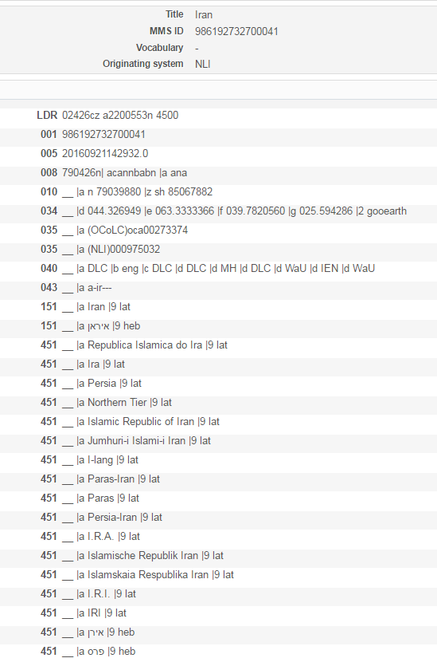
The cataloging process for subjects
A multilingual subject
authority record
Latin preferred term
Hebrew preferred term
Latin non-preferred terms
Hebrew non-preferred terms

Slide 19
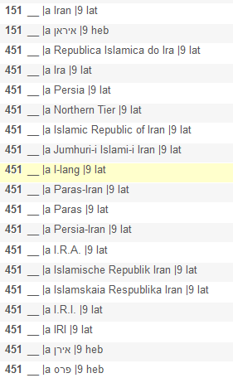
The cataloging process for subjects
Here is the same record “up close”
Latin preferred term
Hebrew preferred term
Latin non-preferred terms
Hebrew non-preferred terms

Slide 20
The cataloging process for subjects
In the specific field where the multilingual authorities are used there will be
2nd indicator 7 and subfield 2 stating which multilingual authority to use
Subfield 9 with relevant language

Slide 21
The cataloging process for subjects
We will now look at two specific cases.
In both cases the same authority record will be used.
In the first case the record is in Latin characters so we will want the subject to also be in Latin characters.
In the second case the record is in Hebrew characters so we want the subject to also be in Hebrew characters.
By using the multilingual authority we are able to maintain authority control while also freely determining in what language the heading would be.

Slide 22
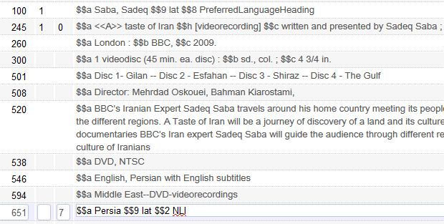
The cataloging process for subjects
Case one: we start by cataloging
651_7 $$a Persia$$9 lat $$2 NLI

Slide 23
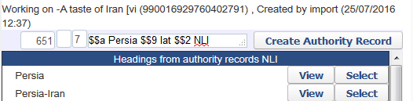
The cataloging process for subjects
After doing F3 we get this
Both of these are non-preferred terms.
We see only headings from the authority record which have subfield 9 “lat” because we have subfield 9 “lat” in the bibliographic heading from which we did F3
If we click “select” for either of these headings …

Slide 24
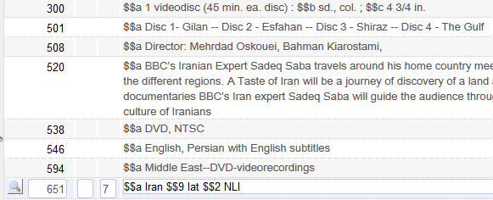
The cataloging process for subjects
We get the preferred term of the authority record and the preferred term is the one which has subfield 9 “lat”
Linked to authority record

Slide 25
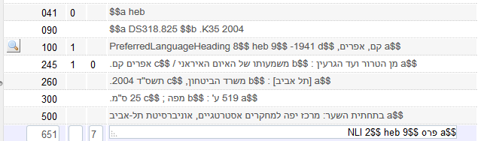
The cataloging process for subjects
Case two: we start by cataloging
651_7 | $$‏a‏ פרס $$‏9‏ heb $$2 NLI

Slide 26
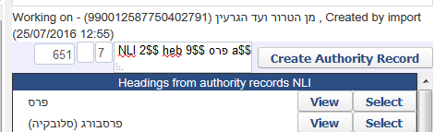
The cataloging process for subjects
After doing F3 we get this
This is a non-preferred term.
We see only headings from the authority record which have subfield 9 “heb” because we have subfield 9 “heb” in the bibliographic heading from which we did F3
If we click “select” for this heading …

Slide 27
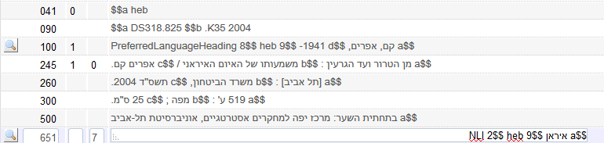
The cataloging process for subjects
We get the preferred term of the authority record and the preferred term is the one which has subfield 9 “heb”
Linked to authority record

Slide 28
Introduction
The cataloging process for names
The cataloging process for subjects
Automated Preferred Term Correction
https://slidemodel.com/templates/animated-rainbow-business-powerpoint-template/
http://image.shutterstock.com/z/stock-photo-business-hand-writing-blank-agenda-list-130255148.jpg

Slide 29
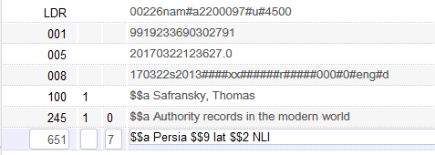
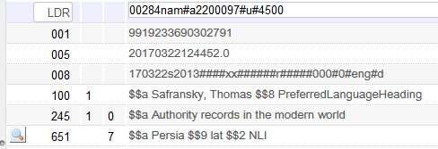
Automated Preferred Term Correction
The link to the authority record is also done automatically on save
Before saving, no link to authority
After saving, have link to authority
The link has been made but the “flip” to the preferred term has not yet been done.

Slide 30
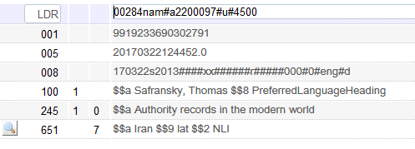
Automated Preferred Term Correction
The job “Authorities - Preferred Term Correction” runs and the heading gets “flipped” to the preferred term

Slide 31
Thank You
https://pixabay.com/en/books-library-shelves-1842306/

